Slide 1
Cognitive Toolkit – Use cases

Slide 2
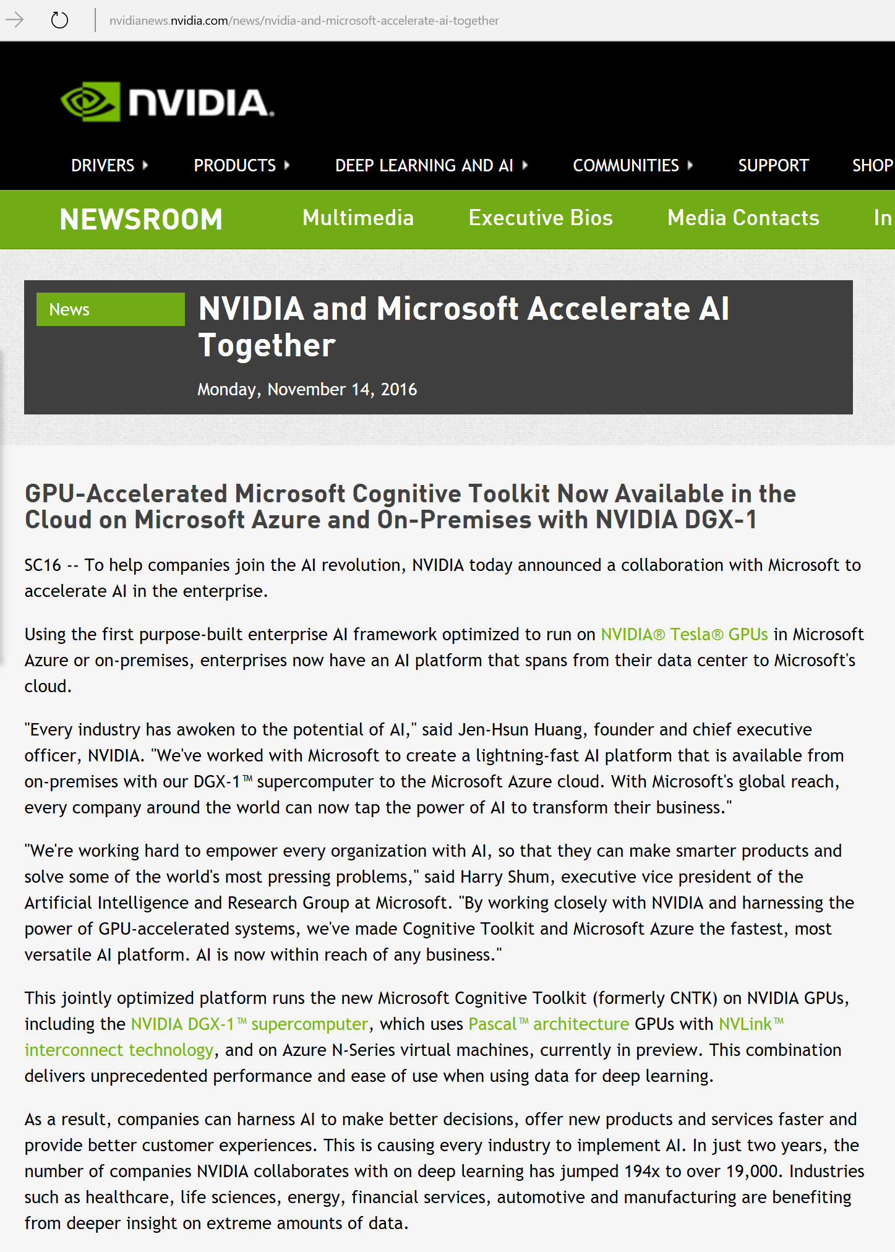



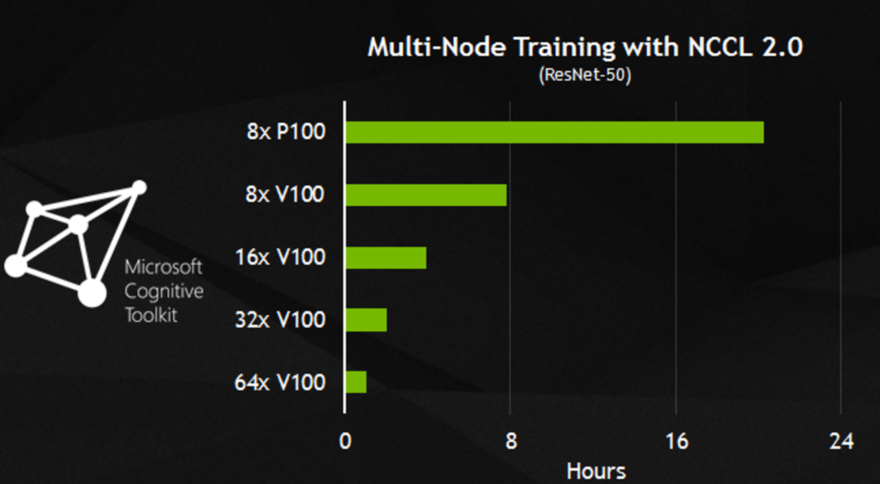
Superior performance
Notes:
At super computing conference 2016 in Salt Lake City, NVIDIA announced deep partnership with Microsoft, to deliver AI to businesses by leveraging speed and scalability powered by Cognitive Toolkit.

Slide 3
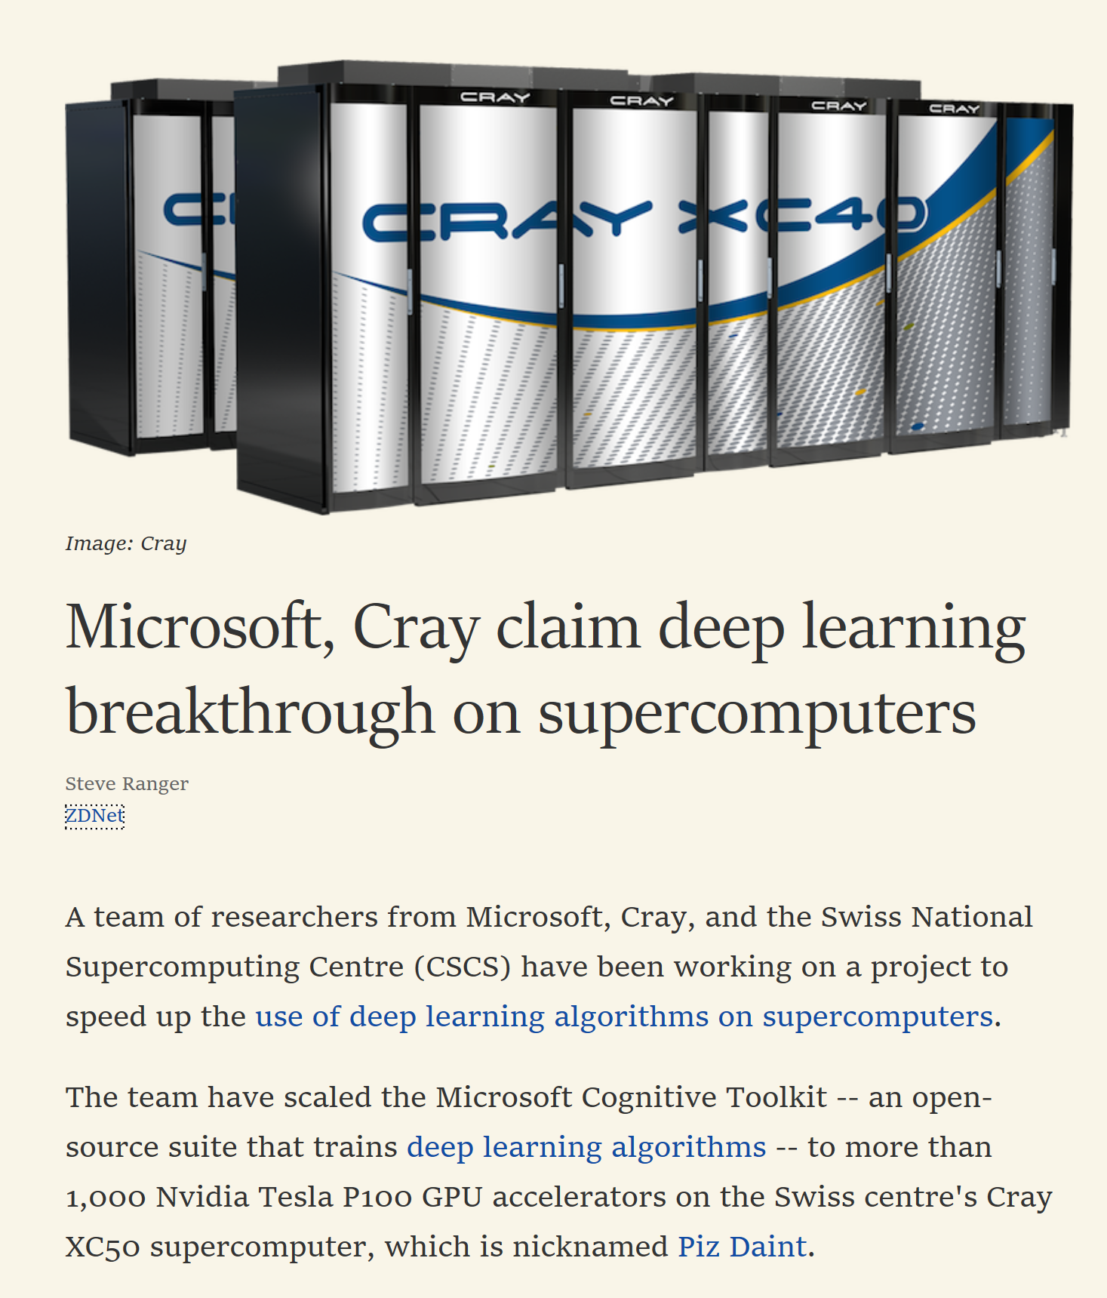
Scalability

Slide 4
Cognitive Toolkit – The Fastest Toolkit
Caffe: 1.0rc5(39f28e4)
CNTK: 2.0 Beta10(1ae666d)
MXNet: 0.93(32dc3a2)
TensorFlow: 1.0(4ac9c09)
Torch: 7(748f5e3)
http://dlbench.comp.hkbu.edu.hk/
Benchmarking by HKBU, Version 8
Single Tesla K80 GPU, CUDA: 8.0 CUDNN: v5.1
 | Caffe | Cognitive Toolkit | MxNet | TensorFlow | Torch
FCN5 (1024) | 55.329ms | 51.038ms | 60.448ms | 62.044ms | 52.154ms
AlexNet (256) | 36.815ms | 27.215ms | 28.994ms | 103.960ms | 37.462ms
ResNet (32) | 143.987ms | 81.470ms | 84.545ms | 181.404ms | 90.935ms
LSTM (256) (v7 benchmark) | - | 43.581ms (44.917ms) | 288.142ms (284.898ms) | - (223.547ms) | 1130.606ms (906.958ms)

Slide 5
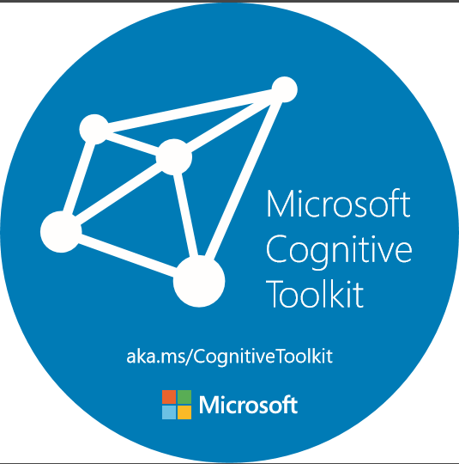



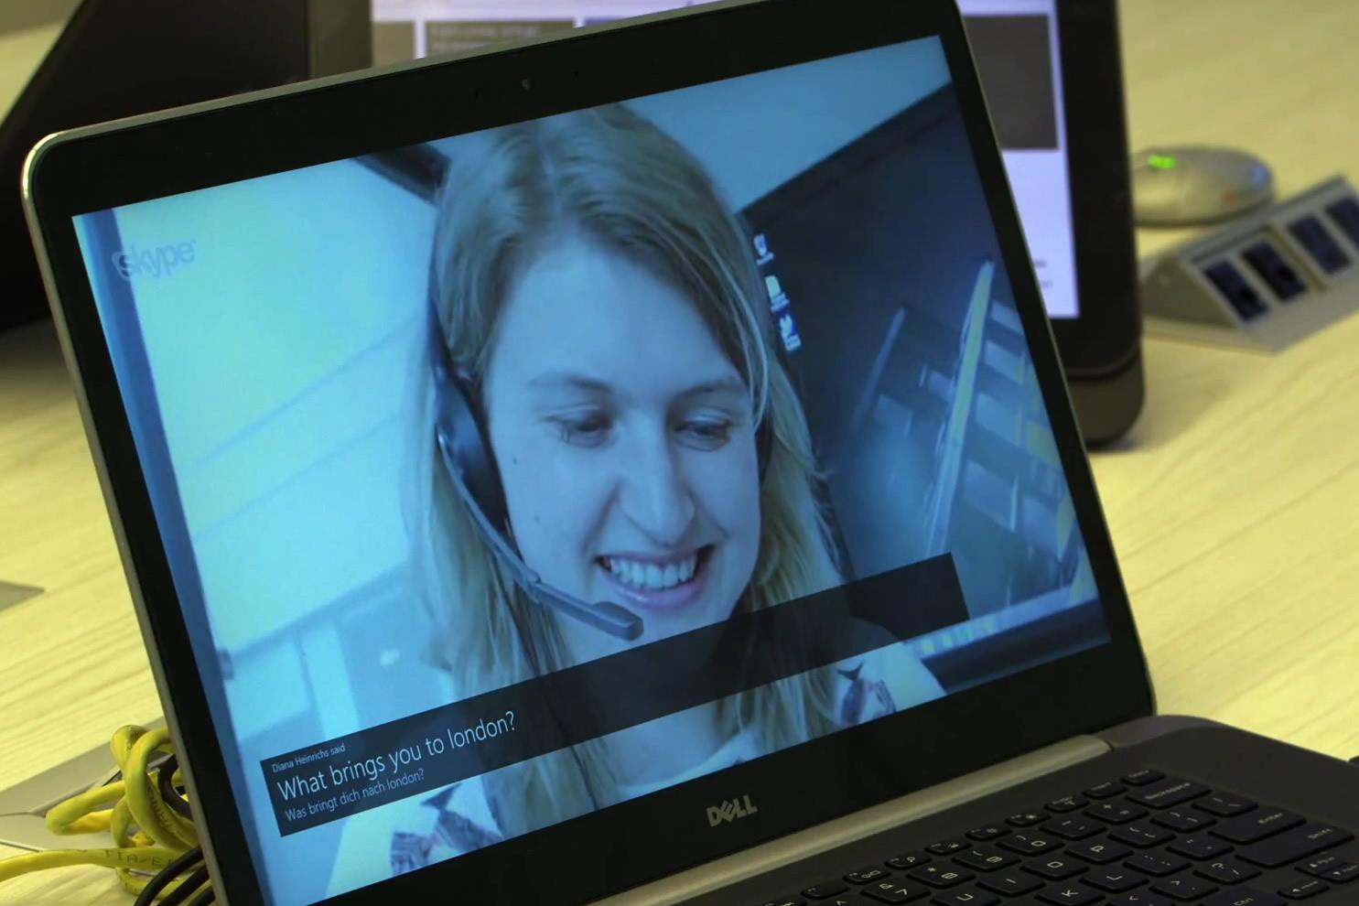
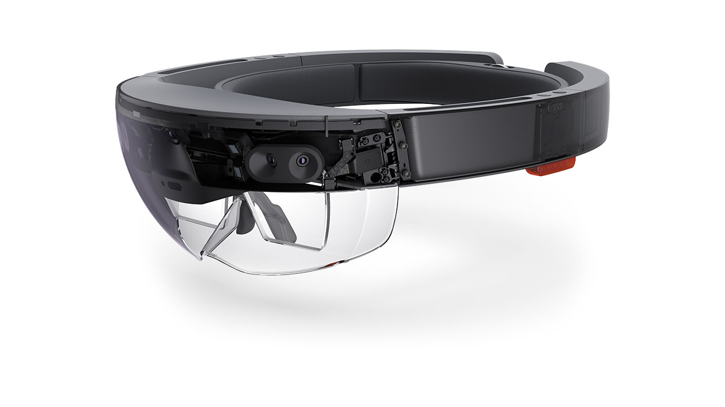



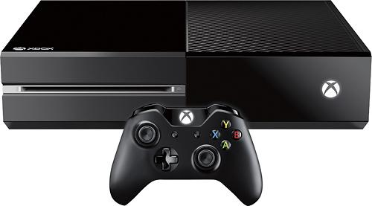

Deep learning at Microsoft
Microsoft Cognitive Services
Skype Translator
Cortana
Bing
HoloLens
Microsoft Research

Slide 6
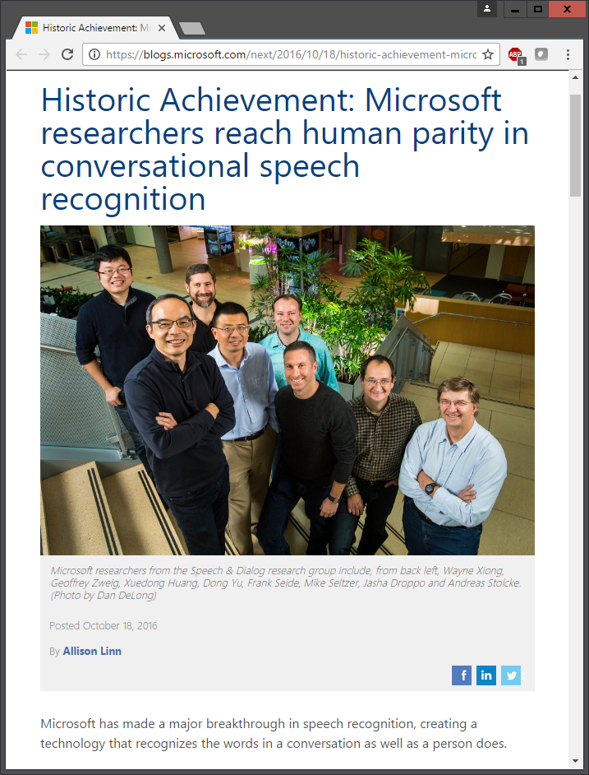
Microsoft’s historic speech breakthrough
Microsoft 2016 research system for conversational speech recognition
5.9% word-error rate
enabled by CNTK’s multi-server scalability
[W. Xiong, J. Droppo, X. Huang, F. Seide, M. Seltzer, A. Stolcke, D. Yu, G. Zweig: “Achieving Human Parity in Conversational Speech Recognition,” https://arxiv.org/abs/1610.05256]

